Slide 1
DLM+Spline Code Verification

Slide 2
Spline+DLM Code
Step 2) DLM: Calculates pressure coefficients over lifting surfaces
Step 3) Pressure coefficients converted to Qij: aerodynamic work done by mode j on mode i
Step 4) Aeroelastic System State space calculation based on Qij’s rational function approximation
Step 1) Spline: Converts mode shape from FEM mesh to DLM mesh
Input: FEM mode shape
Code verified here
Code largely taken from Large wing project
*Implementation of Step 3 is highly dependant on the way in which splines are applied over the aerodynamic surface. Code related to Step 3 used in this verification is different than used for Marge II due to different nature of the problem.

Slide 3
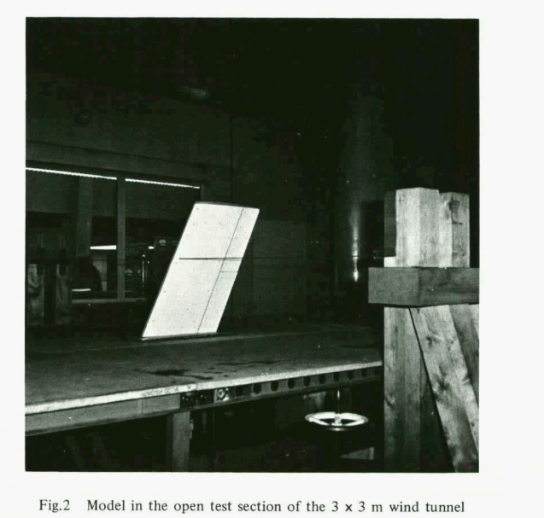
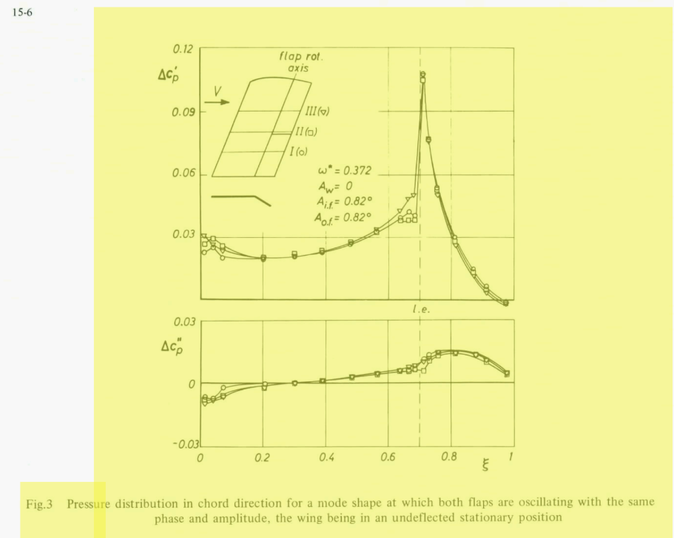
Verification case: AGARD Försching Wing
We conduct verification of the DLM +Spline code by calculating ‘Qij’ for the control surface oscillation mode shape.
Fig. 3 shows the real and imaginary part of the pressure coefficient along the chord at half span.

Slide 4
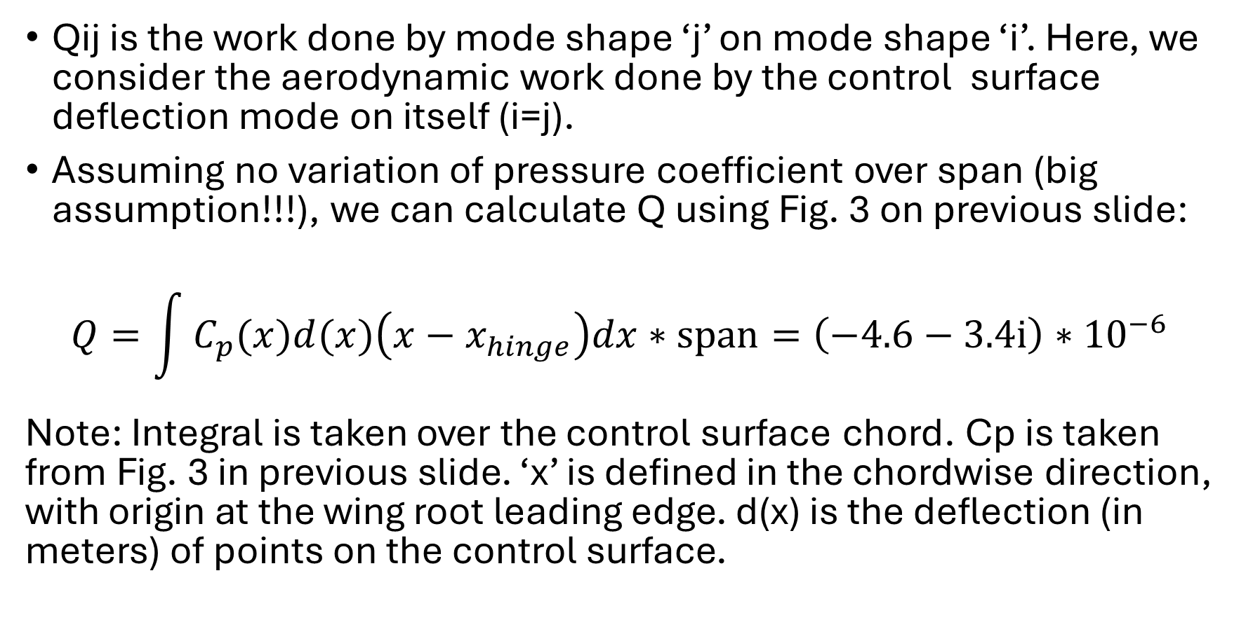
‘Qij’ from Experimental Data
Qij is the work done by mode shape ‘j’ on mode shape ‘i’. Here, we consider the aerodynamic work done by the control surface deflection mode on itself (i=j).
Assuming no variation of pressure coefficient over span (big assumption!!!), we can calculate Q using Fig. 3 on previous slide:
$$Q=\int{C_{p}(x)d(x)\left(x−x_{hinge}\right)dx}∗span=\left(−4.6−3.4i\right){∗10}^{−6}$$
Note: Integral is taken over the control surface chord. Cp is taken from Fig. 3 in previous slide. ‘x’ is defined in the chordwise direction, with origin at the wing root leading edge. d(x) is the deflection (in meters) of points on the control surface.

Slide 5
‘Qij’ from DLM+Spline Code
The input to the code is the motion of four points on the control surface, emulating a FEA mode shape. The code splines between these points to generate the mode shape in the DLM mesh, calculates pressure coefficients and converts it to Q using:
See the next slide for the definitions of the terms
$$Q=\left(−5.9 − 3.5i\right){∗10}^{−6}$$
The value of Q above is different than that obtained using experimental data, probably because we assumed the pressure coefficient to be constant over span when calculating Q from experimental data.
However, the experimental value of Q is close enough to that obtained from my code that I can call it verified.

Slide 6
Definitions of Terms
$\text{\{}{\text{Q}}_{{SE}_{ij}}$} = Self-induced work (as opposed to gust induced) done on ith mode by jth mode
$\text{\{}{\text{ϕ}}_{i_{fp}}$} = ith Mode shape, defining the deflections at the DLM mesh force points (ie: at box quarter chords)
$q_{D}$ = Dynamic Pressure
${\text{Δ}L}_{j}$ = Lift produced by the jth mode
$\text{\{}{\text{ϕ}}_{i_{FE}}$} = ith Mode shape, defining the deflections at the finite element mesh points
$k$= Reduced frequency
$b$= Reference semichord
$A$= Aerodynamic Influence Coefficient Matrix (AIC). This is the output of the DLM code.
$diagS_{ii}$= Diagonal matrix where non-zero entries are the areas of DLM mesh boxes
$T_{h→FE→fp}$= Matrix (which is the output of the spline code) that transforms the deflections at FE nodes to deflections at force points nodes
$T_{h→FE→dw}$= Matrix (which is the output of the spline code) that transforms the deflections at FE nodes to deflections downwash points (ie: at DLM Mesh box ¾ chord)

Slide 7
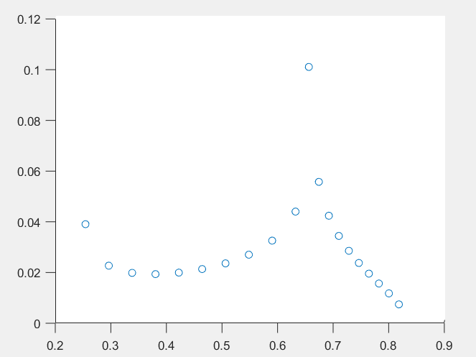
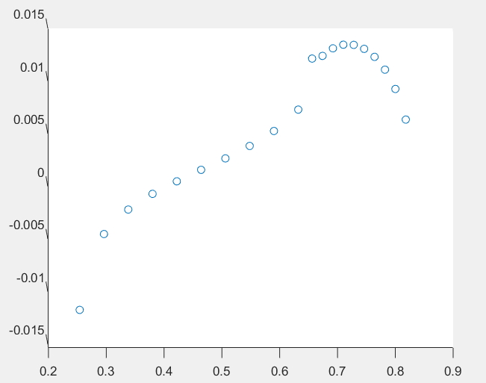
Further Verification
Plots of pressure coefficients obtained from my code at the same spanwise location as in Fig. 3 are presented below (such that plots below and Fig.3 can be directly compared). We see that the plots below are nearly identical to Fig 3, further proving the validity of code. Note: Plots below use the physical locations of points in the x-axis whereas chord-normalized points are used in Fig 3.
Re(Cp)
Im(Cp)
Streamwise (x-axis) location along chord [m]
Streamwise (x-axis) location along chord [m]

